Slide 1
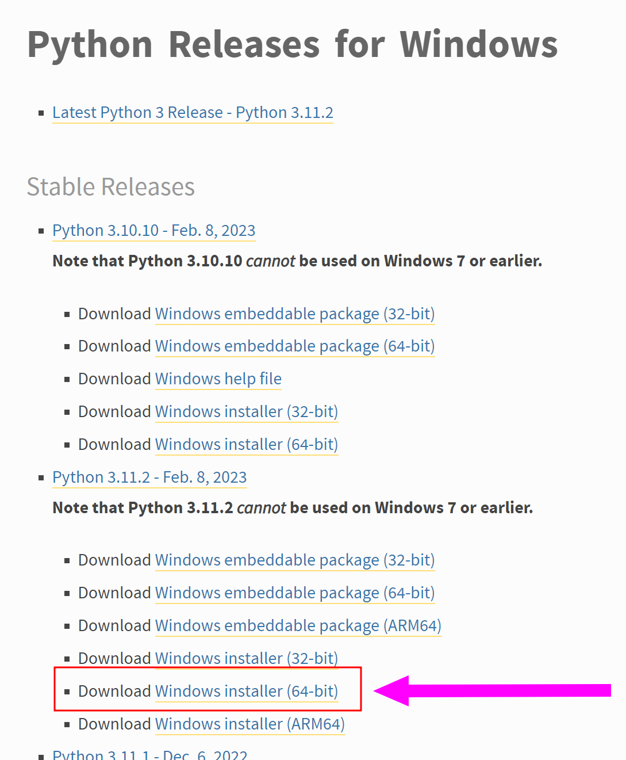
https://www.python.org/downloads/windows/

Slide 2
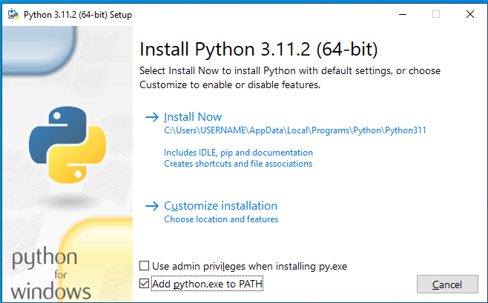
“admin privileges” are not strictly necessary. (if you do some extra PATH work may be necessary)

Slide 3
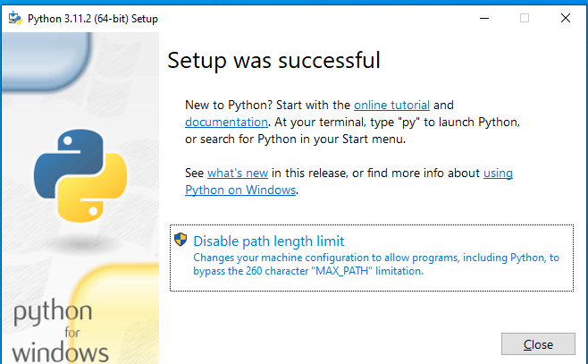
You can skip the “Disable path length limit” (or choose to do it)

Slide 4
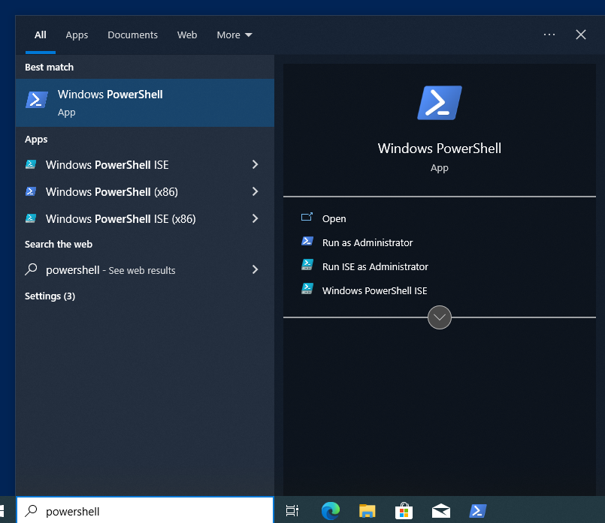
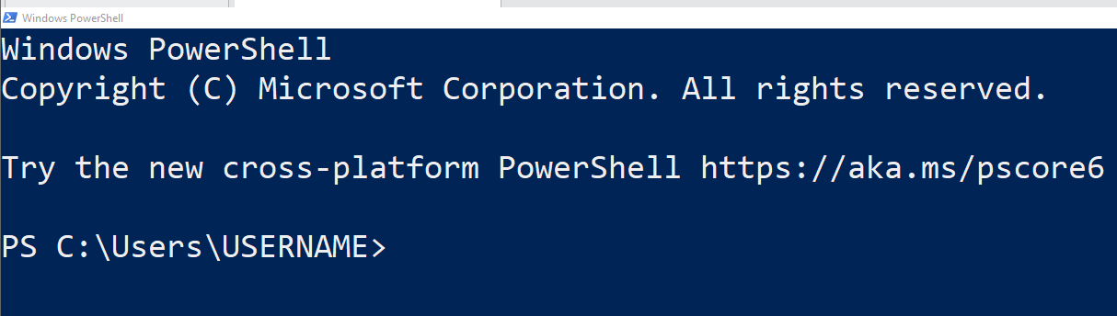
Windows start, “Powershell” (no admin needed)

Slide 5
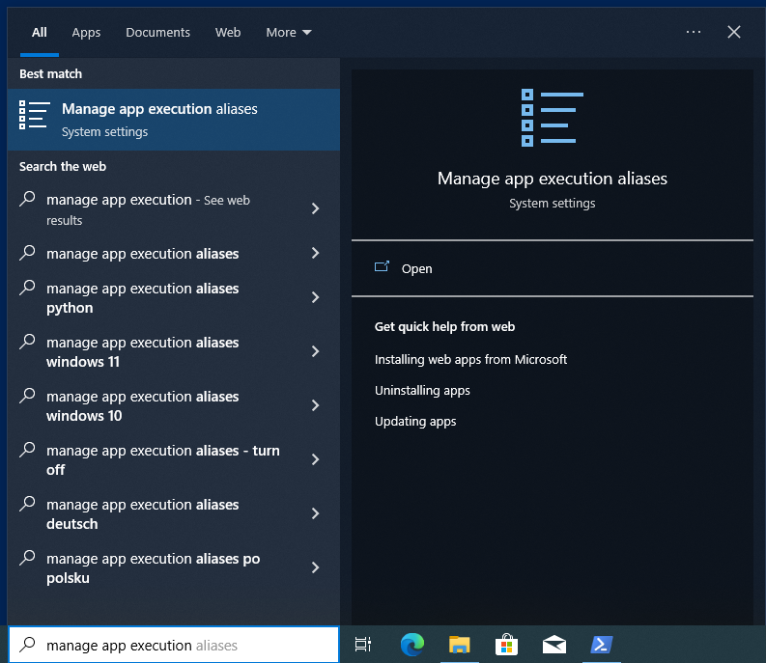
Disable annoying Microsoft Store python3 in path
“Manage app execution aliases”

Slide 6
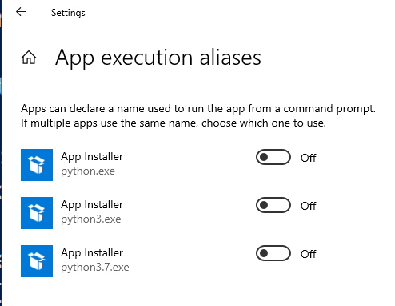

Slide 7
